Slide 1
Breast Cancer prediction Using Machine Learning (ML)

Slide 2
Table of Contents
01
02
03
Problem statement
Litrature survey
Motivation
04
05
Methodology & Algorithm
Experiment
What is the problem to solve?
Previous work done on this problem
what I aimed to achieve
What methodologies and algorithms I used?
What is the actual experiment that I performed?

Slide 3
Table of Contents
01
02
Results
Conclusion
03
04
Future Dimension
Quessions & Answers
What results I got?
Concluding the project
What should be done in future on this project
Any questions? Examiner will ask.

Slide 4
Problem Statement
Breast cancer is a major public health concern worldwide and early detection is crucial for successful treatment. Traditional screening methods such as mammography have limitations, and there is a need for accurate and efficient tools for breast cancer prediction. Machine learning techniques have shown promising results in breast cancer prediction using various datasets. However, there is still a need to develop more accurate and reliable machine learning models that can effectively predict breast cancer risk based on different clinical, pathological and genomic features. Therefore to develop an accurate and reliable machine learning model that can predict the likelihood of breast cancer occurrence using various clinical, pathological and genomic features.

Slide 5
Litrature survey
Year | Findings | Title and Author
2019 | Random forest model gave the highest accuracy of 97.14% | Dhanya et al.
2014 | SVM model gave the highest accuracy of 97.38% | Zheng et al.,
2016 | SVM provides the best level of accuracy (97.13%) at the lowest error rate | Asri et al.,
2020 | ANNs achieve a maximum accuracy of 98.57 percent, SVM accuracy: 97.14 | Islam et al.,
2021 | SVM is utilized to get the new classifier to separate the incoming tumors. Focusing on 10-fold cross validation, the methodology they proposed achieved an improvement of the accuracy to 97.38%, | Naji et al.,

Slide 6
Motivation
The project's aim is to create a diagnostic tool for breast cancer that is precise, reliable, and scalable; this tool will help save lives and improve healthcare outcomes. The capacity of our approach may simplify the process of diagnosing breast cancer presents a potential to revolutionize breast cancer screening while simultaneously expanding its availability to women all over the world.

Slide 7
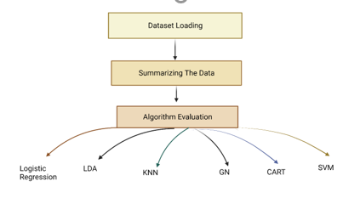
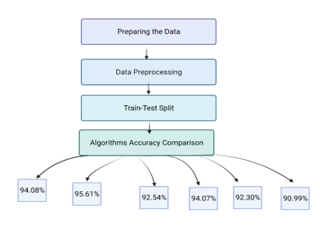
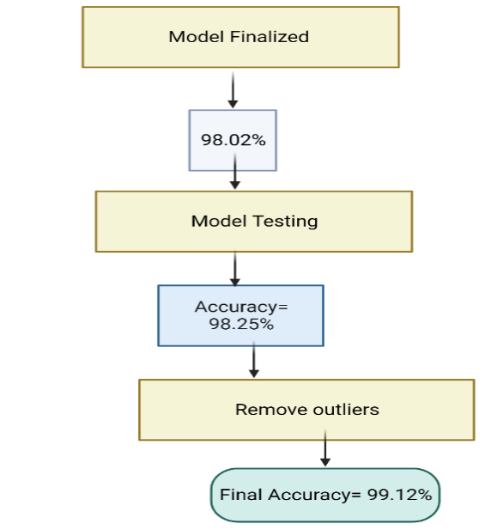
Methodology & Algorithm

Slide 8
Experiment
Data collection
Dataset
Data preparation
Data visualization
Accuracy and comparison before removing outliers
Modeling the data
Accuracy Comparison after removal of outliers
Observation
Outlier removal
Results

Slide 9
Data Collection
The source of the dataset: The dataset available at the UCI Machine Learning Repository, named “Breast Cancer Wisconsin (Diagnostic) Data Set’. The data includes features extracted from digitized images of breast cancer tumors, as well as diagnosis information.
Features / columns: The dataset has 32 columns, including an ID column and a diagnosis column, and the rest are numerical features taken from digitized images of breast cancer tumors. These features include the mean standard error, and “worst” (largest) values of the following 10 real-valued features: radius, texture, perimeter, area, smoothness, compactness, concavity, concave points, symmetry, and fractal dimension.
Volume: The dataset contains data on 569 breast cancer tumors, with 32 columns each.
Author: The original dataset was obtained from the University of Wisconsin Hospitals, Madison, and is part of the UCI Machine Learning Repository. It was donated by Dr. William H, Wolberg, a researcher at the university.

Slide 10
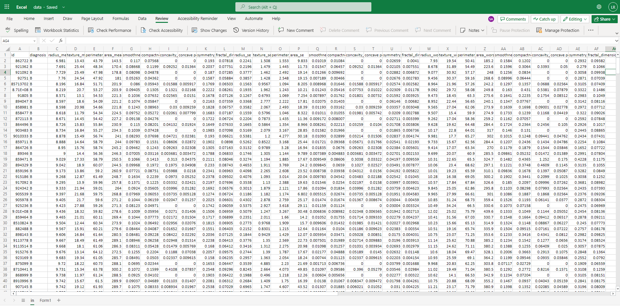
Dataset
DATASET : Breast Cancer Wisconsin (Diagnostic) Data Set

Slide 11
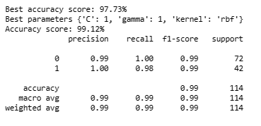
Results
Model | Accuracy
Logistic Regression | 96.94
Linear Discriminant Analysis | 95.61
K-Nearest Neighbor | 97.15
Gaussian Naive Bayes | 94.29
Classification And Regression Tree | 91.22
Support Vector Machines | 97.82

Slide 12
Conclusion
In conclusion, the SVM classification model proved effective in correctly classifying diagnoses of breast cancer with a high degree of accuracy. This work provides evidence that support vector machines (SVMs) are successful in classification tasks, particularly in medical diagnosis. Achieving a high percentage of accuracy(99.12) was the goal I aimed from the start, and this was done when I removed outliers and some extra features while proceeding SVM model. You can enter a subtitle here if you need it

Slide 13

Serving Humanity

Slide 14
Future Dimensions
In terms of future work, various areas can be explored to expand the work I’ve done so far. For instance, increasing the dataset. This could be accomplished by gathering extra data or combining information from different sources, as well as the usage of medical images as these has a crucial role in breast cancer prediction.

Slide 15
Any Questions?
You may ask

Slide 16
References
Asri, H., Mousannif, H., Moatassime, H. A., & Noel, T. (2016). Using Machine Learning Algorithms for Breast Cancer Risk Prediction and Diagnosis. Procedia Computer Science, 83, 1064–1069. https://doi.org/10.1016/j.procs.2016.04.224
Breast Cancer - an overview | ScienceDirect Topics. (2016). Sciencedirect.com. https://www.sciencedirect.com/topics/medicine-and-dentistry/breast-cancer
Islam, Md. M., Haque, Md. R., Iqbal, H., Hasan, Md. M., Hasan, M., & Kabir, M. N. (2020). Breast Cancer Prediction: A Comparative Study Using Machine Learning Techniques. SN Computer Science, 1(5). https://doi.org/10.1007/s42979-020-00305-w
Song, P. N., Mansur, A., Dugger, K. J., Davis, T. R., Howard, G., Yankeelov, T. E., & Sorace, A. G. (2020). CD4 T-cell immune stimulation of HER2 + breast cancer cells alters response to trastuzumab in vitro. Cancer Cell International, 20(1). https://doi.org/10.1186/s12935-020-01625-w

